Slide 1
Localization
NC 812/ESD 812

Slide 2
Introduction
In many circumstances, it is useful or even necessary for a node in a IoT/WSN to be aware of its location in the physical world. For example, tracking or event-detection. Not much use if we cannot provide any information where an event has happened.
To do so, usually, the reporting nodes’ location has to be known. Manually configuring location information into each node during deployment may not be an option. Similarly, equipping every node with a Global Positioning System (GPS) receiver fails because of cost and deployment limitations e.g., GPS, does not work indoors.

Slide 3
Localization: Why?
Each individual sensor observation can be characterized as a tuple of the form <S, T, M>, where S is the spatial location of the measurement, T is the time of measurement, and M is the measurement itself.
1. To provide location stamps
2. To locate and track point objects
3. To monitor spatial evolution
4. To determine quality of coverage
5. To achieve load balancing: in topology control mechanisms.
6. To form clusters
7. To facilitate routing
8. To perform efficient spatial querying.

Slide 4
Key Issues
1. When to localize?
  Location information for all unknown nodes is needed at the beginning and only once in static environment. In other cases, information may need to be refreshed periodically.
2. How to localize?
  Different signal measurements can be used for localization. UWB/RF signals, acoustic/ultrasound signals, infrared etc. The signals may be emitted and measured by reference or unknown nodes or both. Basic localization algorithm may be based on a number of techniques such as, proximity, centroids, ranging, angulation etc.

Slide 5
Key Issues
How well to localize?
  Positioning accuracy is the largest distance between the estimated and the true position of an entity (high accuracy indicates a small maximal mismatch). Precision is the ratio with which a given accuracy is reached, averaged over many repeated attempts to determine a position.
Where to localize?
  Where should the computations be done? At the central entity where all component information is collected or in a distributed manner within unknown nodes? The choice will depend upon resource constraint at the nodes, whether the node being localized is cooperative or not etc.

Slide 6
Localization Approaches
Coarse grained localization using minimal information: These typically use small set of discrete measurements (binary proximity, can the two nodes hear each other?), near-far information (which of the two nodes are closer to the node in question), or is one node to the north/south/east/west of other node?
Fine grained localization: these are based on measurements such as RF power, signal waveform, time stamp etc.

Slide 7
Localization Approaches
Range-based
  Use exact measurements (point-to-point distance estimate (range) or angle estimates)
  More expensive
  Ranging: the process of estimating the distance between the pair of nodes
Range-free
  Only need the existences of beacon signals
  Cost-effective alternative to range-based solutions

Slide 8
Localization Approaches
Beacon Nodes know their locations
Range-based Algorithms
  Sensor nodes need to measure physical distance-related properties
  How to measure distance
    RSSI (Received Signal Strength Indication)
    ToA (Time of Arrival)
    TDOA (Time Difference of Arrival)
  How to estimate location
    MMSE (Minimum Mean Square Estimation)
Range Free Algorithms
  Do Not involve distance estimation

Slide 9
Localization Approaches
Proximity
The simplest technique is to exploit the finite range of wireless communication. It can be used to decide whether a node that wants to determine its position or location is in the proximity of an anchor. While this only provides coarse-grain information, it can be perfectly sufficient.
A set of reference nodes are placed in the environment in some almost non-overlapping manner. The reference node (or unknown node) emit beacons periodically. The reference node beacon must include their location ID which will allow the unknown node to determine which node it is closest to .

Slide 10
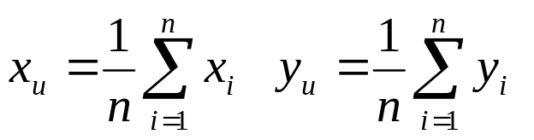
Proximity Based Approaches
Centroid Calculation: When the density of reference nodes is high, location of an unknown node can be determined by,
Where n is the number of reference nodes. The centroid technique models each mode having a simple circular range R and the nodes being separated by distance d. It has been shown by simulations that, as the overlap ratio R/d increases from 1 to 4, the localization error is reduced from d/2 to d/4.

Slide 11
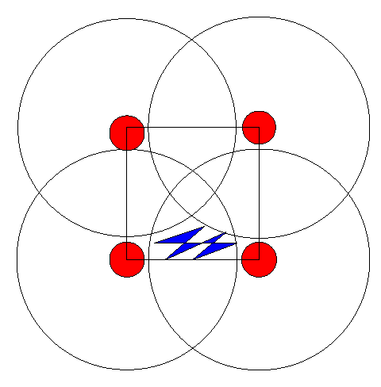
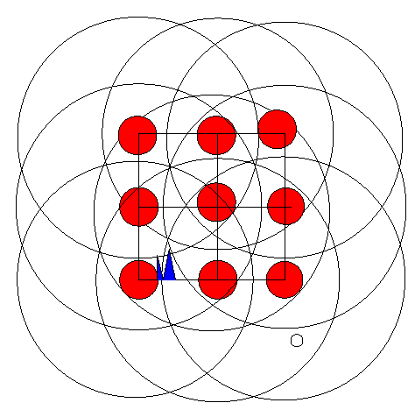
Range-free: Centroid
Idea: Do not use any ranging at all, simply deploy enough beacons
Anchors periodically broadcast their location
Localization:
  Listen for beacons
  Average locations of all anchors in range
  Result is location estimate
Good anchor placement is crucial!
Anchors

Slide 12
Lateration vs. Angulation
In addition to connectivity/proximity information, the communication between two nodes allows to extract information about their geometric relationship. For example, the distance between two nodes or the angle in a triangle can be estimated.
When distances between entities are used, the approach is called lateration; when angles between nodes are used, one talks about angulation.
For lateration in a plane, the simplest case is for a node to have precise distance measurements to three non-colinear anchors. The extension to a three-dimensional space is trivial (four anchors are needed). Using distances and anchor positions, the node’s position can be determined.

Slide 13
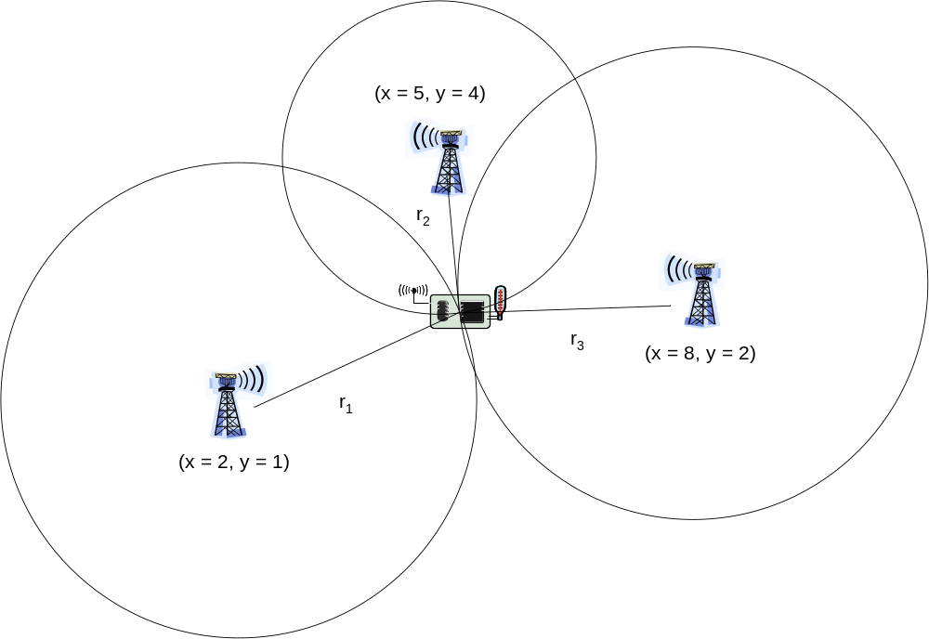
Trilateration

Slide 14
Estimating Distance: RSSI
Issues:
  Rapid, random changes in the wireless channel resulting in varying RSSI. Can be resolved by averaging over multiple measurements
  The cheaper devices need to calibrated in such a way that the distance estimate is consistent.
  Absence of line-of-sight can result in incorrect distance measurements that cannot be corrected using any averaging.

Slide 15
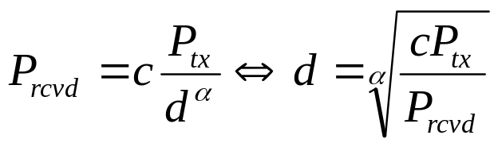
Estimating Distance: RSSI
Assuming that the transmission power P_{tx}, the path loss model, and the path loss coefficient α are known, the receiver can use the received signal strength P_{rcvd} to solve for the distance d in a path loss equation,
No additional hardware is necessary and distance estimates can be derived without additional overhead from communication that is taking place anyway.
The disadvantage, is that RSSI values are not constant but can heavily oscillate, even when sender and receiver do not move. This is caused by effects like fast fading and mobility of the environment – ranging errors of ±50% are reported.

Slide 16
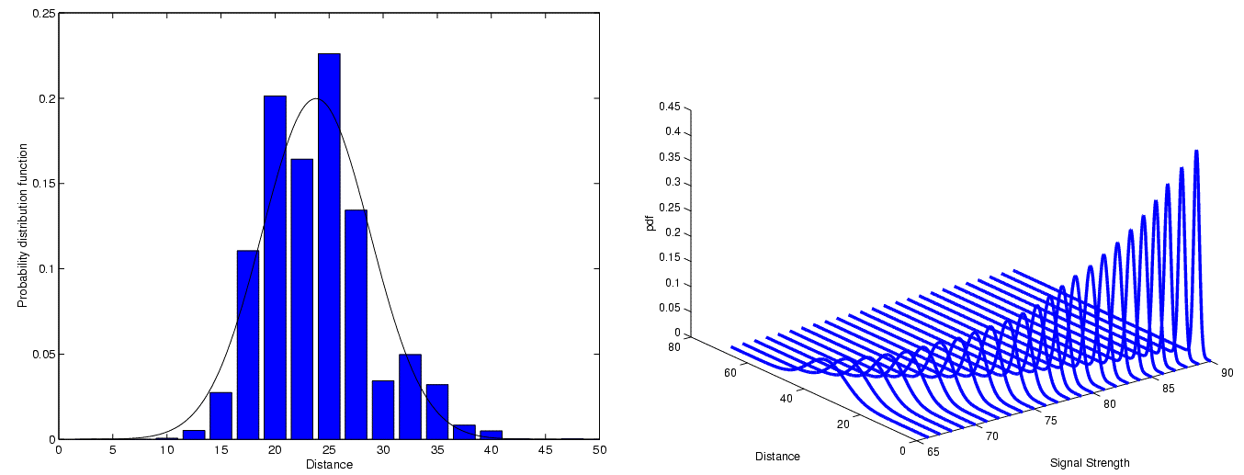
Estimating distances – RSSI
PDF
PDF
Distance
Distance
Signal strength

Slide 17
Estimating distances
Time of arrival (ToA)
  Use time of transmission, propagation speed, time of arrival to compute distance
  Problem: Exact time synchronization
Time Difference of Arrival (TDoA)
  Use two different signals with different propagation speeds
  Example: ultrasound and radio signal
    Propagation time of radio negligible compared to ultrasound
  Compute difference between arrival times to compute distance
  Problem: Calibration, expensive/energy-intensive hardware

Slide 18

Trilateration
Assuming distances to three points with known location are exactly given
Solve system of equations (Pythagoras!)
  (x_{i},y_{i}) : coordinates of anchor point i, r_{i} distance to anchor i
  (x_{u}, y_{u}) : unknown coordinates of node
  Subtracting eq. 3 from 1 & 2:

Slide 19


Trilateration
  Rearranging terms gives a linear equation in (x_{u}, y_{u})!
  Rewriting as a matrix equation:

Slide 20

Trilateration as matrix equation
Example: Let the location of the reference nodes be given as, (x₁, y₁) = (2,1), (x₂, y₂) = (5,4), (x₃, y₃) = (8,2),
The distances are given as, r₁ = 3.1623 , r₂ = 2, r₃ = 3.
Determine the location of the sensor.
! (x_{u},y_{u}) = (5,2)

Slide 21
Distance Errors
The real challenge for triangulation arises when the distance measurements are not perfect but only estimates ˜r with an unknown error ε are known. Solving the above equations with ˜r_{i} = r_{i} + ε_{i} will in general not yield the correct values for the unknown positions (x_{u}, y_{u}).
The intuitive solution to this problem is to use more than three anchors and redundant distant measurements to account for the error in each individual measurement. Mathematically, this turns the above equations into an over-determined system of equations.

Slide 22
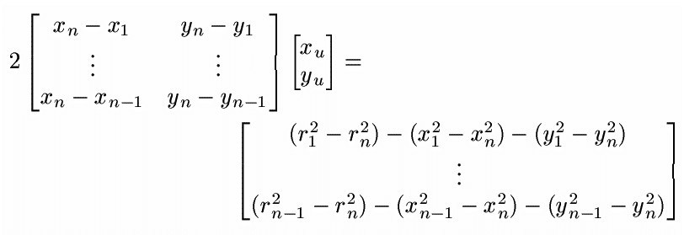

Trilateration with distance errors
Use (x_{u}, y_{u}) that minimize mean square error, i.e,

Slide 23

Minimize mean square error
For such an over-determined system of linear equation, a solution can be computed that minimizes the mean square error, that is, the solution is the pair (x_{u}, y_{u}) that minimizes |Ax − b|₂. where A is an n−1×2 matrix, x = (x_{u}, y_{u}) a shorthand for the vector describing the unknown position, and b is an n−1 column vector.
Since the second norm of a vector is minimized, this reflects solving for the position that best satisfies, with minimum average error, all the position constraints from all n anchors.
Look at square of the of Euclidean norm expression (note that for all vectors v)

Slide 24

Minimize mean square error
Look at derivative with respect to x, set it equal to 0:
  Normal equation
  Has unique solution (if A has full rank), which gives desired minimal mean square error
Essentially similar for angulation as well

Slide 25
Example
Example: Let the location of the reference nodes be given as, (x₁, y₁) = (2,1), (x₂, y₂) = (5,4), (x₃, y₃) = (8,2),
The distances are given as, r₁ = 3.1623 , r₂ = 2, r₃ = 3.
With accurate distance measurements, the position was computed as (5,2).
Now, assume that for the three anchors only incorrect position estimates ˜r1 = 5, ˜r2 = 1, and ˜r3 = 4 are available. Solving the resulting equation corresponding gives the incorrect position (5.2, 4.8) with a distance of (5.2 − 5)² + (4.2 − 2)² ≈ 2.2 between estimated and correct position.

Slide 26
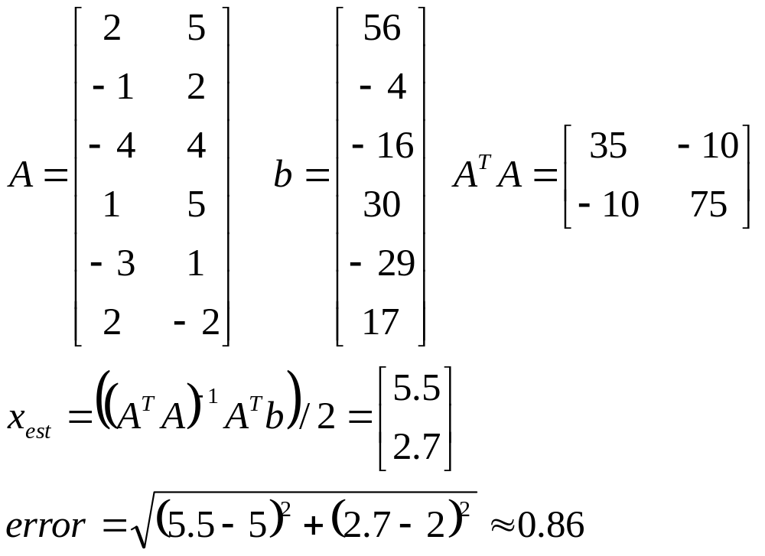
Example
Adding additional anchors at (x₄, y₄) = (3, 1), (x₅, y₅) = (7, 5), (x₆, y₆) = (2, 8), and (x₇, y₇) = (4, 6) with distance estimates ˜r4 = 2, ˜r5 = 3, ˜r6 = 7, and ˜r7 = 4, respectively should improve this estimate.

Slide 27
Localization
Using the basic building blocks of distance/range or angle measurements and the mathematical basics, quite a number of positioning or locationing systems have been developed. The systems where a node with unknown position can directly communicate with anchors is classified as single hop localization systems.
Active Badge: The “Active Badge Location System” is the first system designed and built for locating simple, portable devices within a building. It uses diffused infrared as transmission medium and exploits the natural limitation of infrared waves by walls as a delimeter for its location granularity.
A badge periodically sends a globally unique identifier via infrared to receivers, at least one of which is installed in every room. is in the same room as a particular given badge.

Slide 28
Localization
Active office: Receivers placed at well-known position, mounted in array at the ceiling of a room; devices for which the position is to be determined act as ultrasound senders. When the position of a specific device it to be determined, a central controller sends a radio message, containing the device’s address. The device, upon receiving this radio message, sends out a short ultrasound pulse.
This pulse is received by the receiver array that measures the time of arrival and computes the difference between time of arrival of the ultrasound pulse and the time of the radio pulse.
Using this time, a distance estimate is computed for every receiver and a multi-lateration problem is solved, computing a position estimate for the mobile device.

Slide 29
Global Positioning System
The Global Positioning System (GPS) is a network of about 24 satellites orbiting the Earth at an altitude of 20,000 km. The system was originally developed by the US government for military navigation.
Wherever you are on the planet, at least four GPS satellites are ‘visible’ at any time. Each one transmits information about its position and the current time at regular intervals. These signals, travelling at the speed of light, are intercepted by your GPS receiver, which calculates how far away each satellite is based on how long it took for the messages to arrive.
Once it has information on how far away at least three satellites are, your GPS receiver can pinpoint your location using trilateration.

Slide 30
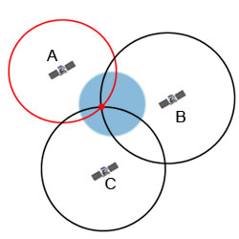
GPS

Slide 31
GPS
Each GPS satellite continuously broadcasts a navigation message at 50 bits per second on carrier frequency of approx 1600 MHz. All satellites broadcast at 1575.42 MHz (this is the L1 signal) and 1227.6 MHz (the L2 signal).
The GPS signal gives the precise "time-of-week" according to the satellite's on-board atomic clock, the GPS week number and a health report for the satellite so that it can be discounted if faulty. Each transmission lasts 30 seconds and carries 1500 bits of encrypted data. This small amount of data is encoded with a high-rate pseudo-random (PRN) sequence that is different for each satellite. GPS receivers know the PRN codes for each satellite and so can not only decode the signal but distinguish between different satellites.

Slide 32
GPS Receiver
General procedure:
  Acquire one satellite to get time and almanac
  Acquire 2 other satellites to get 2-D position
  Acquire 4th satellite to get 3-D position
  Acquire any other visible satellite
Time needed to get good position:
  Hot start: few secs (rcv was off for a few secs: almanac ok, time ok, position close to last one)
  Warm start: few mins (rcv was off for less than a day: clock ~ok)
  Cold start: 10s of minutes (rvc was off for several days: time off, almanac expired, last position off)

Slide 33
Decoding at the Receiver
Radio frequency (RF) part of the receiver processes incoming signals:
  L1 only (single-frequency receivers)
  L1 and L2 (dual-frequency receivers)
RF unit:
  Processes incoming signal from different satellites in different channels (multichannels receivers, 4 to 12 channels)
  Generates internal replica of the GPS signal:
    Contains an oscillator (= clock) that generates L1 and L2 frequencies
    Knows each PRN code (almost…)
Compares internally generated signal with incoming signal

Slide 34
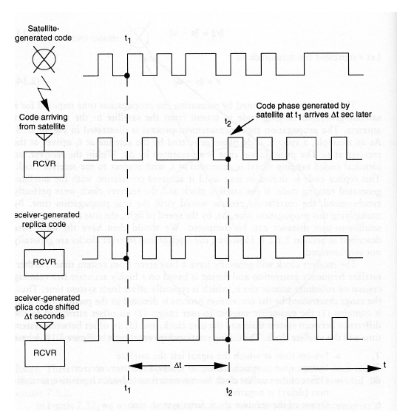
REceiver

Slide 35
Sources of Error
Ionosphere and troposphere delays - The satellite signal slows as it passes through the atmosphere. The GPS system uses a built-in model that calculates an average amount of delay to partially correct for this type of error.
Signal multipath - This occurs when the GPS signal is reflected off objects such as tall buildings or large rock surfaces before it reaches the receiver. This increases the travel time of the signal, thereby causing errors.
Receiver clock errors - A receiver's built-in clock is not as accurate as the atomic clocks onboard the GPS satellites. Therefore, it may have very slight timing errors.

Slide 36
Locating a Mobile Phone (911 services)
To locate a mobile telephone geographically, there are two general approaches. One is to use radiolocation from the cellular network; the other is to use a Global Positioning System receiver built into the phone itself.
Radiolocation in cellular telephony uses base stations. Most often, this is done through triangulation between radio towers.
The location of the handset can be determined several ways:
Angle of arrival (AOA) requires at least two towers, locating the caller at the point where the lines along the angles from each tower intersect.

Slide 37
Locating a Mobile
Time difference of arrival (TDOA) works using multilateration, except that it is the networks that determine the time difference and therefore distance from each tower.
Location signature uses "fingerprinting" to store and recall patterns (such as multipath) which mobile phone signals are known to exhibit at different locations in each cell.

Slide 38
WiFi Positioning System
Wi-Fi positioning system (WPS) or WiPS/WFPS is used where GPS is inadequate due to various causes including multipath and signal blockage indoors. Wi-Fi positioning uses of large number of wireless access points in urban areas.
Based on measuring the intensity of the received signal (received signal strength indication or RSSI) and the method of "fingerprinting".
Typical parameters useful to geolocate the Wi-Fi hotspot include the SSID and the MAC address of the access point. The Wi-Fi hotspot database gets filled by correlating mobile device GPS location data with Wi-Fi hotspot MAC addresses.
The possible signal fluctuations that may occur can increase errors and inaccuracies in the path of the user.

Slide 39
WiFi Trilateration
The simplest way for estimation distances between receiver and transmitter is a using of free-space path loss model:
FSPL = 20log10(d) + 20log10(f) – 27.55
where, d is the transmitter-receiver separation distance in meters, f is the signal frequency in megahertz, FSPL is received signal strength path loss in dBm.

Slide 40
WiFi Trilateration
Free space path loss is not an accurate model for channel, as a result RSSI will be different than estimated by the equation shown earlier

Slide 41
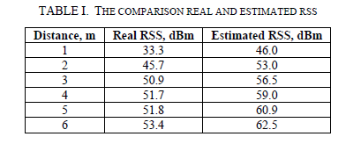
WiFi Trilateration

